Slide 1
PG-DAC February 2020 Introduction to DBMS

Slide 2
Duration : 60 hours
Theory : 30 hours
Lab : 30 hours
Evaluation
Theory Exam : 40% [ CDAC is going to conduct ]
Lab Exam : 40% [ SunBeam is going to conduct ]
Internal Exam : 20% [ SunBeam is going to conduct ]
Database : MySQL
Reference Book
MySQL Developer’s Library – Paul DuBois( Pearson )

Slide 3
Session 1
Introduction to DBMS
What is DBMS
Need of DBMS
Areas Where DBMS are used
Data Models
Relational Data Model

Slide 4
What is Data?
An unorganized and raw things.
It is simple and useless until we process it.
Example:
Random numbers
Unknown characters
Symbol
Images

Slide 5
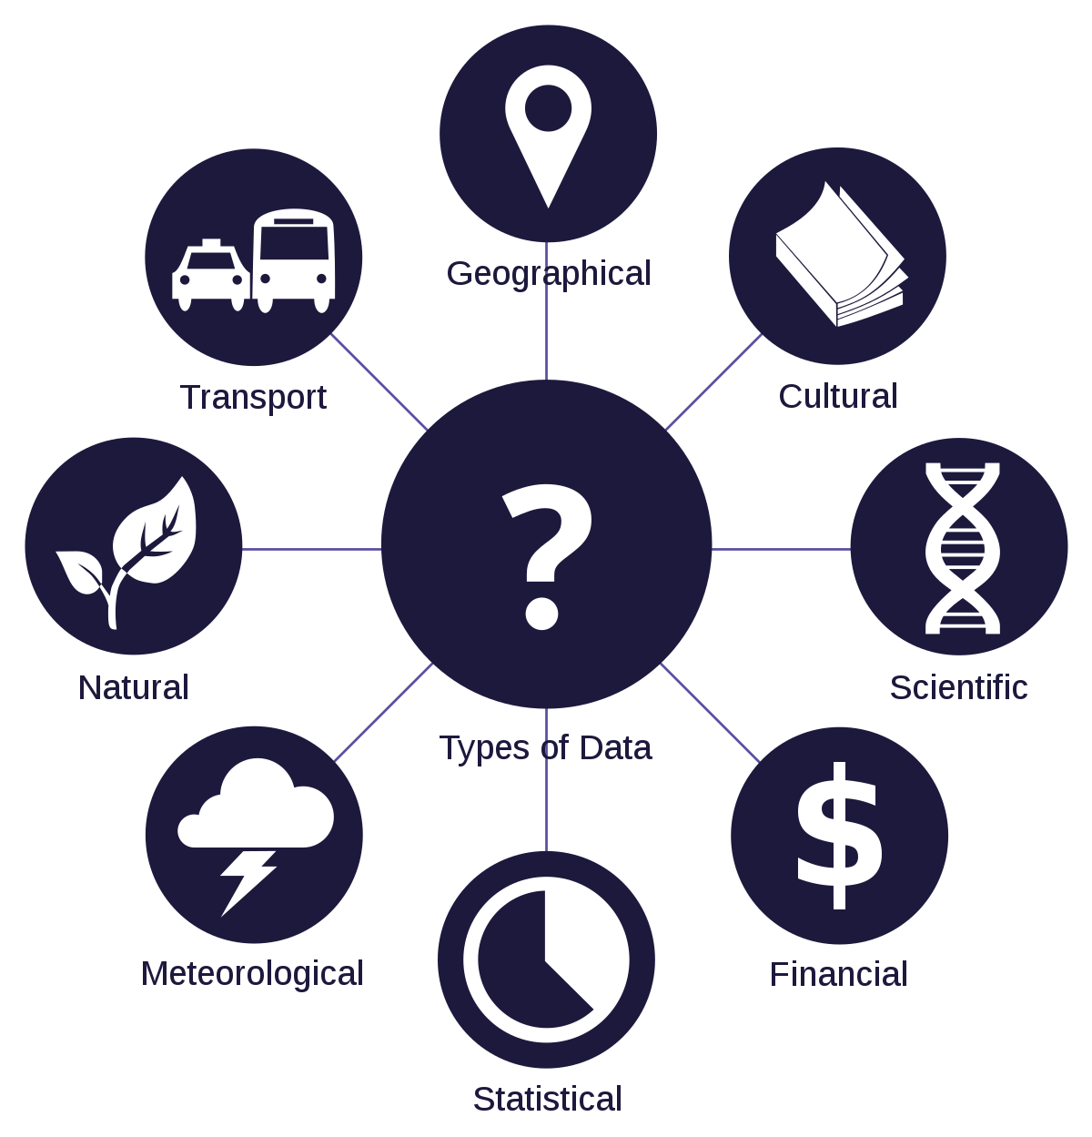
What is Data?

Slide 6
What is Information?
The work done by the computer to convert data into processing is called processing.
The process of searching, sorting, grouping or calculating data is called data processing.
Processed data is called as information.

Slide 7
What is Information?
What does the number 23071983 means?
A birthday?( 23rd July 1983 )
A bank account number?
A telephone number?
A club membership number?
Without processing data is meaningless.

Slide 8
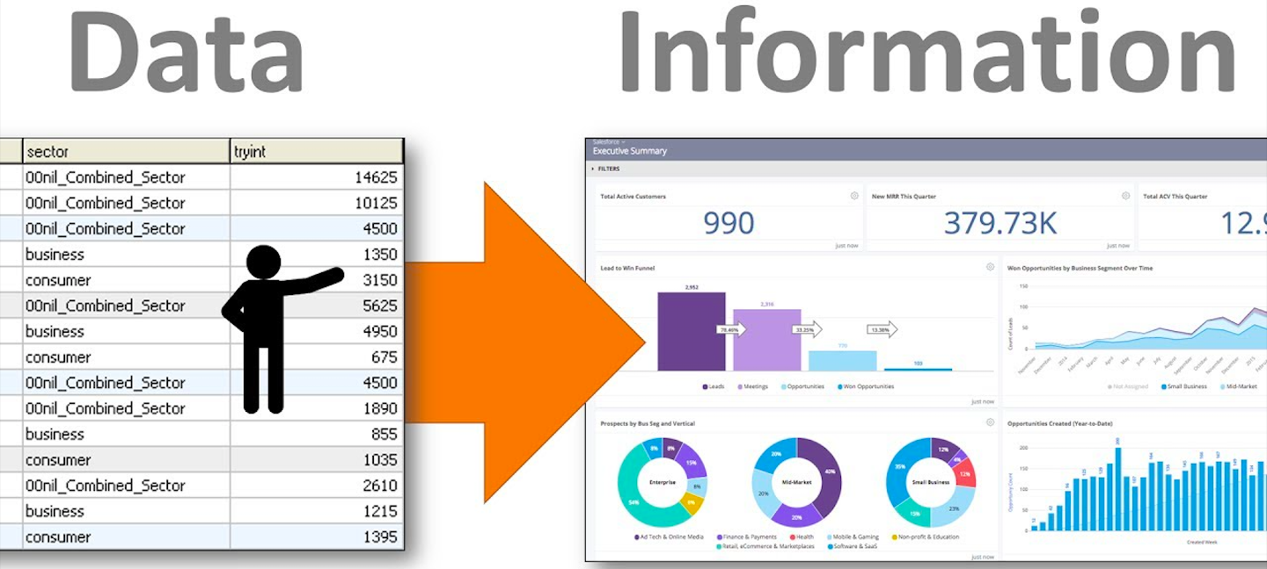

Slide 9
What is Database?
It is a collection of large amount of data.
It contains coherent and meaningful data.
Common Examples
Address Book
Telephone Dictionary
Students Record

Slide 10
What is Database?
Example: Postal Address.
A building name
A flat number
A road name
An area name
A state name
A pincode
A country name
The postal address is data and Address book is a database.
The address book could be termed as a coherent collection of data.

Slide 11
What is DBMS?
Database Management System.
It is a readymade software that helps to manage the data.
ANSI definition is :
It is collection of interrelated data(database) and a set of programs to access those data.

Slide 12
What is DBMS?
The primary goal of DBMS is to provide a way to store and retrieve database information that is both convenient and efficient.
It allows us to insert, update, delete and process data.
Example:
MS Excel, FoxPro, Tally etc.

Slide 13
Need Of DBMS
In the early days, database applications were built directly on top of file systems, which leads to:
Data redundancy and inconsistency
Data is stored in multiple file formats resulting in duplication of information in different files
Difficulty in accessing data
Need to write a new program to carry out each new task
Data isolation
Multiple files and formats

Slide 14
Need Of DBMS
Integrity Problems
Data integrity refers to the problem of ensuring that database contains only accurate data.
Atomicity Problems
Failures may leave database in an inconsistent state with partial updates carried out
Example: Transfer of funds from one account to another should either complete or not happen at all

Slide 15
Need Of DBMS
Concurrent access by multiple users
Concurrent access needed for performance
Uncontrolled concurrent accesses can lead to inconsistencies
Ex: Two people reading a balance (say 100) and updating it by withdrawing money (say 50 each) at the same time
Security problems
Hard to provide user access to some, but not all, data.
Database management system offers solution to the all above problems.

Slide 16
Database System Applications
Enterprise Information
Sales: For customer, product, and purchase information.
Accounting: For payments, receipts, account balances, assets and other accounting information.
Human resources: For information about employees, salaries, payroll taxes, and benefits, and for generation of pay checks.
Manufacturing: For management of the supply chain and for tracking production of items in factories, inventories of items in warehouses and stores, and orders for items.
Online retailers: For sales data noted above plus online order tracking, generation of recommendation lists, and maintenance of online product evaluations.

Slide 17
Database System Applications
Banking and Finance
Banking: For customer information, accounts, loans, and banking transactions.
Credit card transactions: For purchases on credit cards and generation of monthly statements.
Finance: For storing information about holdings, sales, and purchases of financial instruments such as stocks and bonds; also for storing real-time market data to enable online trading by customers and automated trading by the firm.
Navigation systems:
For maintaining the locations of varies places of interest along with the exact routes of roads, train systems, buses, etc.

Slide 18
Database System Applications
Universities:
For student information, course registrations, and grades.
Airlines:
For reservations and schedule information. Airlines were among the first to use databases in a geographically distributed manner.
Telecommunication:
For keeping records of calls made, generating monthly bills, maintaining balances on prepaid calling cards, and storing information about the communication networks

Slide 19
Data Models
A collection of conceptual tools for describing data, data relationships, data semantics, and consistency constraints.
A data model provides a way to describe the design of a database at the physical, logical, and view levels.
There are number of different data models:
Relational
Entity Relationship ( Mainly for DB design )
Object-Based (Object-oriented and Object-relational )
Semistructured ( XML )
Other older Models:
Hierarchical Data Model ( tree like structure )
Network Data Model

Slide 20
Relational Data Model
It uses a collection of Relations to represent both data and the relationships among those data. Relation is also called as ”Table / Entity Class”.
Each table contains records of a particular type. Record is also called as “Row or Tuple/Entity”.
Each record type defines a fixed number of fields, or attributes. Attribute is also called as “Column”.
Collection of columns and rows is a table.

Slide 21
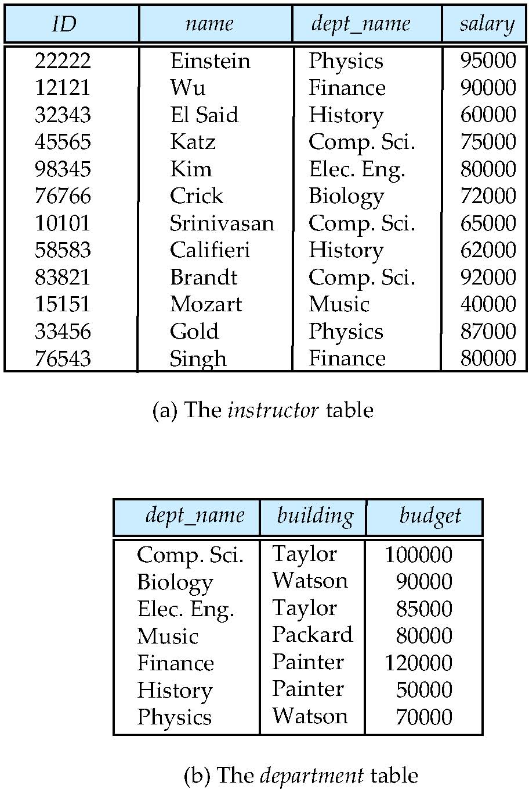
Relational Data Model
The model was introduced by E.F. Codd in 1970.
All the data is stored in tables.
Columns
Rows

